Slide 1


Dr. Marius Terblanche | Clinical Consultant in Critical Care Medicine, Guy’s & St. Thomas’ NHS Foundation Trust, London, UK | @mterblance2 @GSTT_ICU

Slide 2
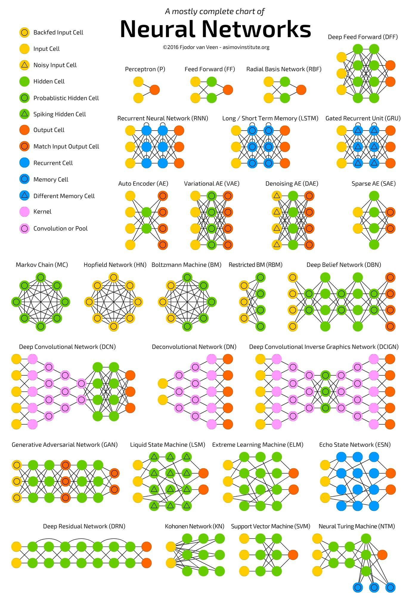

Conflict of interest statement
Founder:
ideation.AI Ltd
Part-time senior associate:
Deloitte UK Health Tech practice
Tech geek
All views are my own

Slide 3











Slide 4







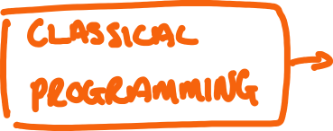





Slide 5
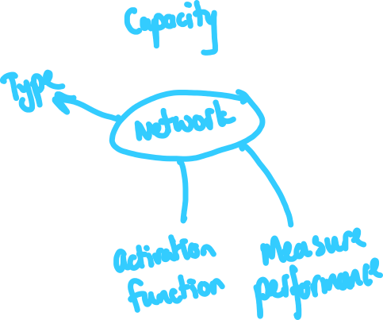










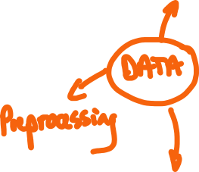


Slide 6







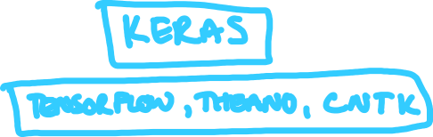










Slide 7
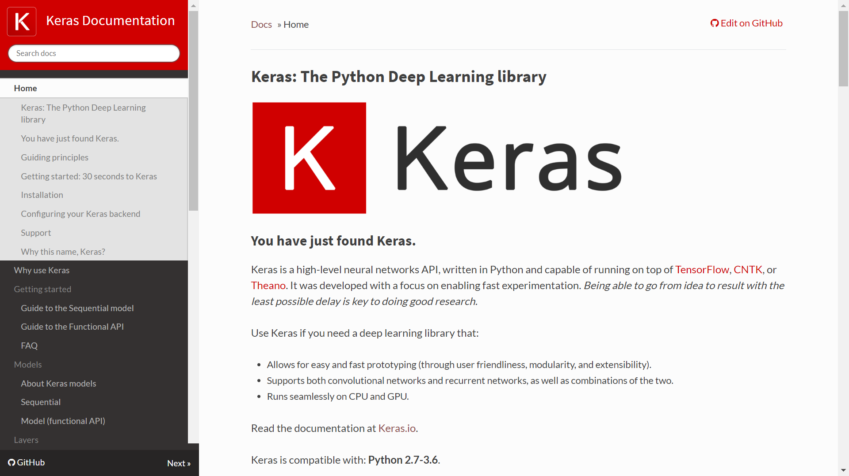

Slide 8


Slide 9















Slide 10



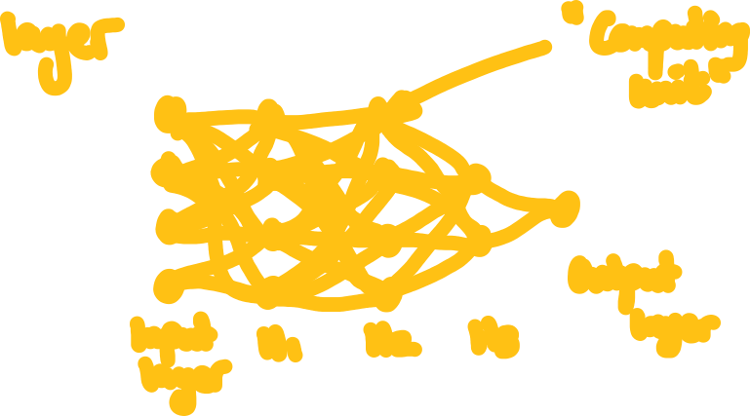

Slide 11
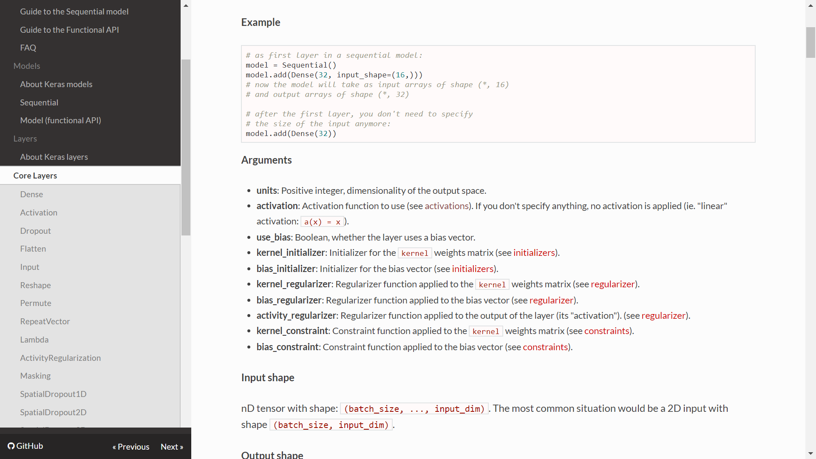

Slide 12
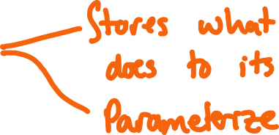








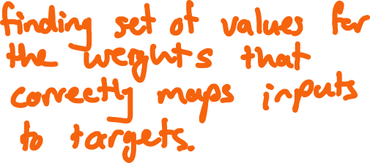

Slide 13

















Slide 14
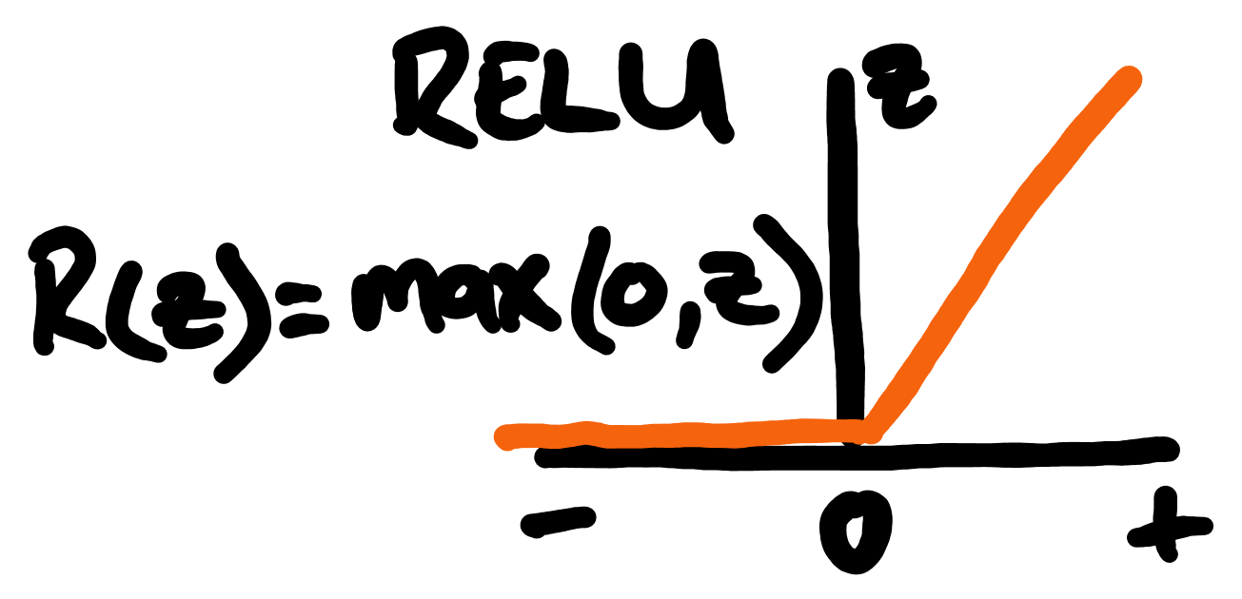
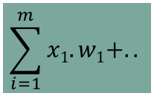
Math heavy lifting inside each ‘neuron’…
Inputs
Weights
X₁
W₁
Activation function
Node
X₂
W₁
$$\sum_{i=1}^{m}{x1.w1+..}$$
Nett input
Output
X₃
W₃
Process summation
X₄
W₄
Y = f(X)

Slide 15
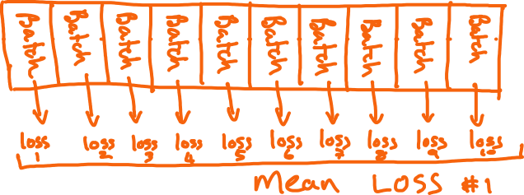










Slide 16
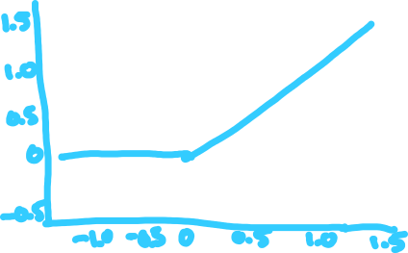




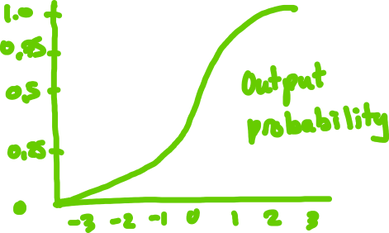





Slide 17
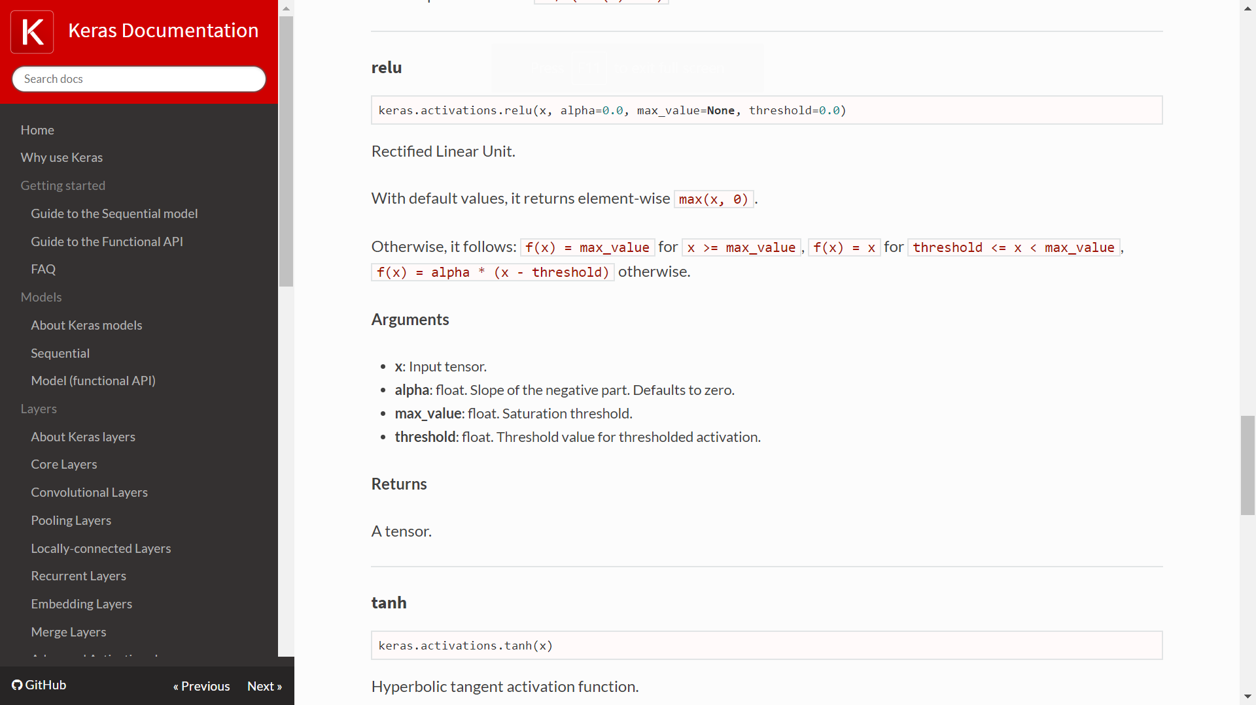

Slide 18


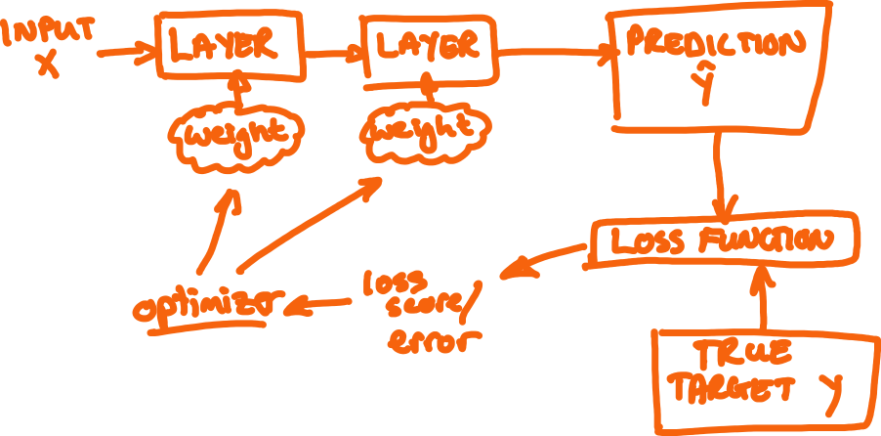





Slide 19
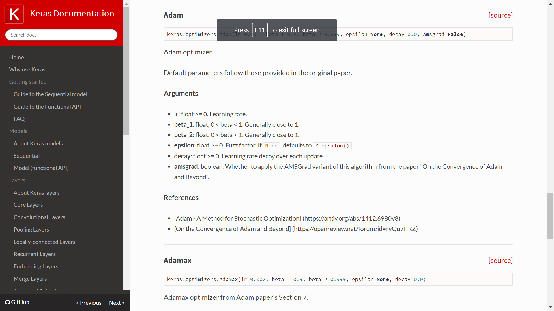

Slide 20


















Slide 21










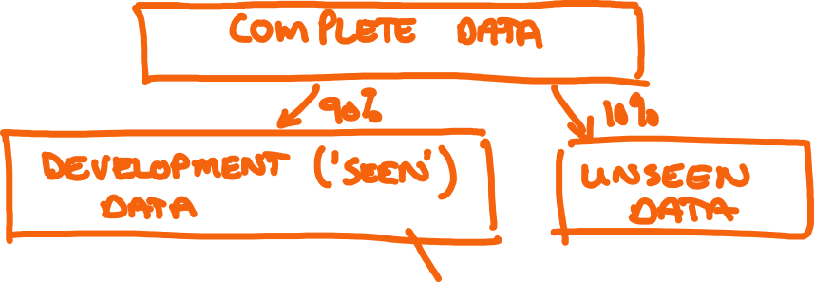

Slide 22
Model performance

Slide 23
















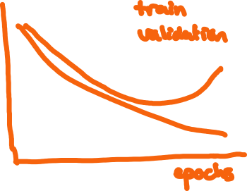


Slide 24






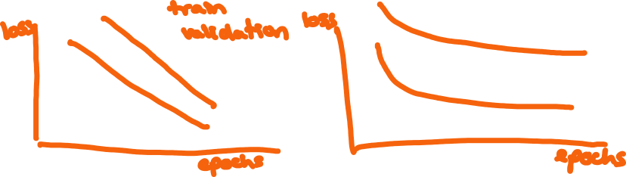
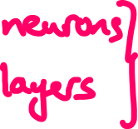




Slide 25



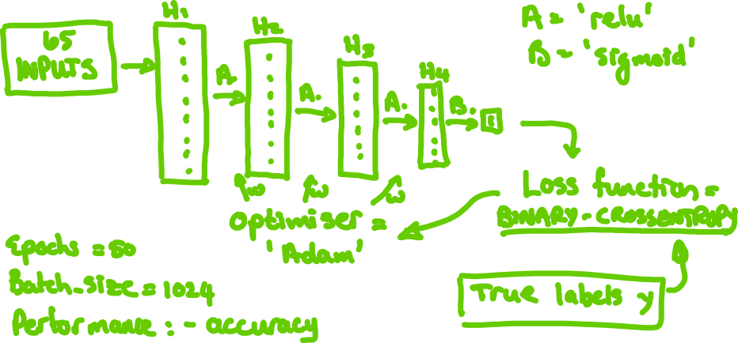


Slide 26


